Slide 1
Introduction to Software Engineering
Requirements Modeling (System Analysis)
Muhammad Nasir
m.nasir@iiu.edu.pk

Slide 2
Agenda
Requirement Analysis
  Scenario-based Models
  Data Models
  Class-oriented Models
  Flow-Oriented Models
  Behavioral Models
Domain Analysis

Slide 3
Requirement Modeling
Software engineering begins with a series of modeling tasks
that lead to a specification of requirements and a design representation for the software to be built.
The requirements model actually a set of models—is the first technical representation of a system

Slide 4
Requirement Modeling
Requirements analysis results in the specification of software’s operational characteristics, indicates software’s interface with other system elements, and establishes constraints that software must meet.

Slide 5
Requirement Modeling
The requirements modeling action results in one or more of the following types of models:
  Scenario-based Models of requirements from the point of view of various system “actors”
  Data Models that depict the information domain for the problem

Slide 6
Requirement Modeling
Class-oriented Models that represent object-oriented classes (attributes and operations) and the manner in which classes collaborate to achieve system requirements
Flow-oriented Models that represent the functional elements of the system and how they transform data as it moves through the system
Behavioral Models that depict how the software behaves as a consequence of external “events”

Slide 7
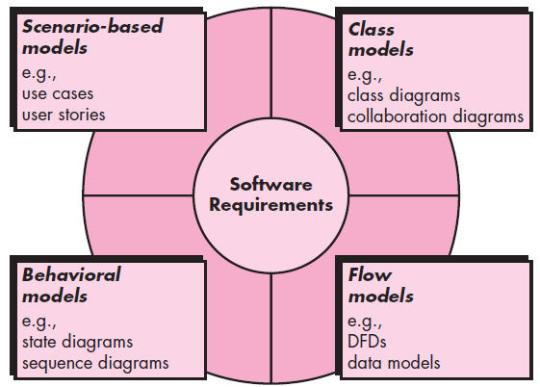
Elements of Analysis Model

Slide 8
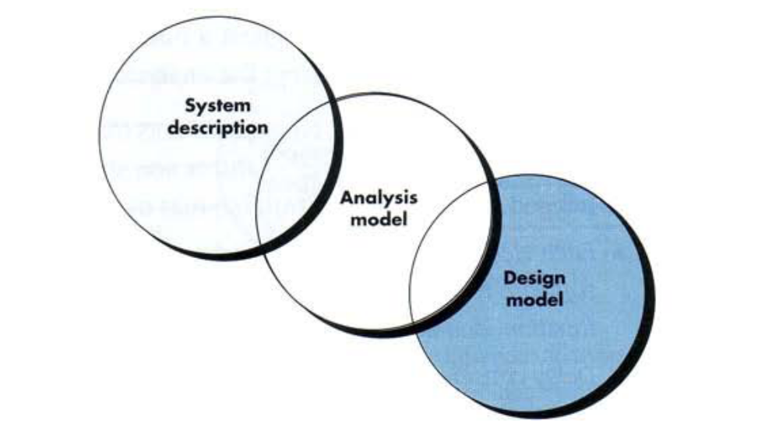
Requirement Modeling

Slide 9
Analysis Rules of Thumb
The model should focus on requirements that are visible within the problem or business domain. The level of abstraction should be relatively high.
Each element of the analysis model should add to an overall understanding of software requirements, function and behavior of the system.
Delay consideration of infrastructure and other non-functional models until design.

Slide 10
Analysis Rules of Thumb
Minimize coupling throughout the system. - If level of interconnectedness is high, efforts should be made to reduce it.
Assured that the analysis model provides value to all stakeholders. – business stakeholder should validate requirement, Designers should use the model as a basis for design.

Slide 11
Domain Analysis
Analysis patterns often reoccur across many applications within a specific business domain.
If these patterns are defined and categorized in a manner that allows you to recognize and apply them to solve common problems, the creation of the analysis model speed-up.
More important, the likelihood of applying design patterns and executable software components grows dramatically.
This improves time-to-market and reduces development costs.
Notes:
Expedite: To speed up the progress of; facilitate.

Slide 12
Domain Analysis
“Software domain analysis is the identification, analysis, and specification of common requirements from a specific application domain, typically for reuse on multiple projects within that application domain. . . .”

Slide 13
Domain Analysis
[Object-oriented domain analysis is] the identification, analysis, and specification of common, reusable capabilities within a specific application domain, in terms of common objects, classes, subassemblies, and frameworks…

Slide 14
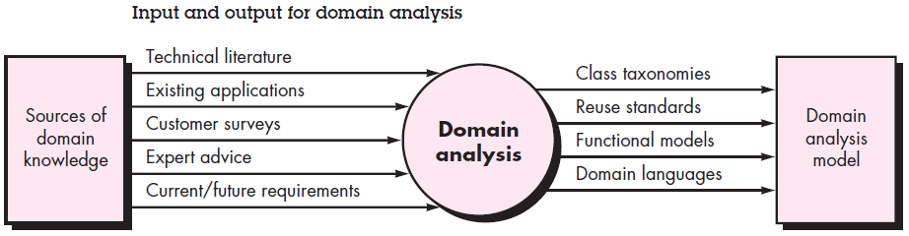
Domain Analysis

Slide 15
Scenario-based Modeling
Use cases develops the understanding that how the system would be used.
Hence, requirements modeling with UML begins with the creation of scenarios in the form of use cases, activity diagrams, and swimlane diagrams.

Slide 16
Scenario-based Modeling
In general, use cases are written first in an informal narrative fashion.
If more formality is required, the same use case is rewritten using a structured format

Slide 17
Writing Preliminary Use-Cases
In SafeHome Example a Home owner might interact in following way
  Select camera to view.
  Request thumbnails from all cameras.
  Display camera views in a PC window.
  Control pan and zoom for a specific camera.
  Selectively record camera output.
  Replay camera output.
  Access camera surveillance via the Internet.

Slide 18
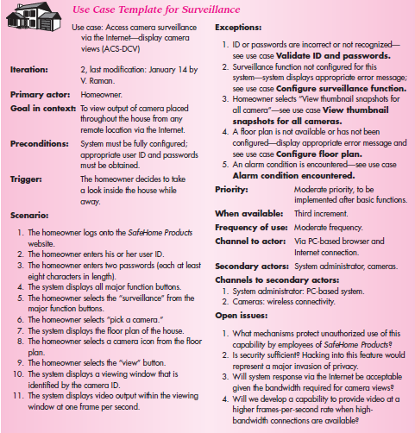
Writing a Formal Use-Case

Slide 19
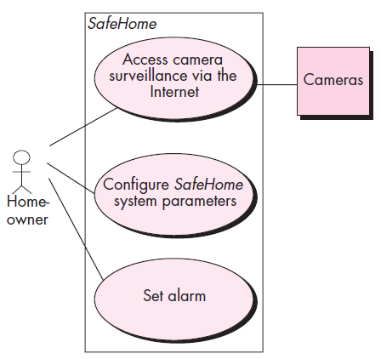
Preliminary Use-Case Diagram for SafeHome

Slide 20
The End
Thanks for listening
Questions would be appreciated.

